Slide 1

Emotion Recognition Using EEG signals
Presented by:
Haya Aldawsari

Slide 2
Outline
01 | What is Emotion Recognition?
02 | What is an EEG?
03 | Challenges of ER using EEG
04 | Roadmap of developing DL model for ER
05 | Conclusion and future work

Slide 3

What is Emotion Recognition?
Emotion recognition is the process of identifying human emotions.
Recognizing your emotions and learning to manage them is one of the most important skills you can have.
The ability to recognize your emotions and calm yourself down or adjust your behavior increases your chances of succeeding in life, forming healthy relationships, and handling challenges well.
Notes:
Emotions can be recognized through facial expressions, voice tune, and phisiological signals.

Slide 4
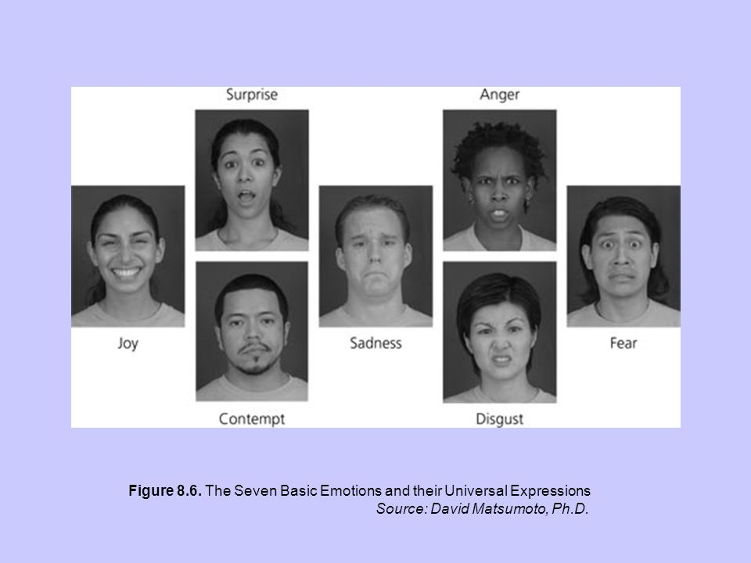
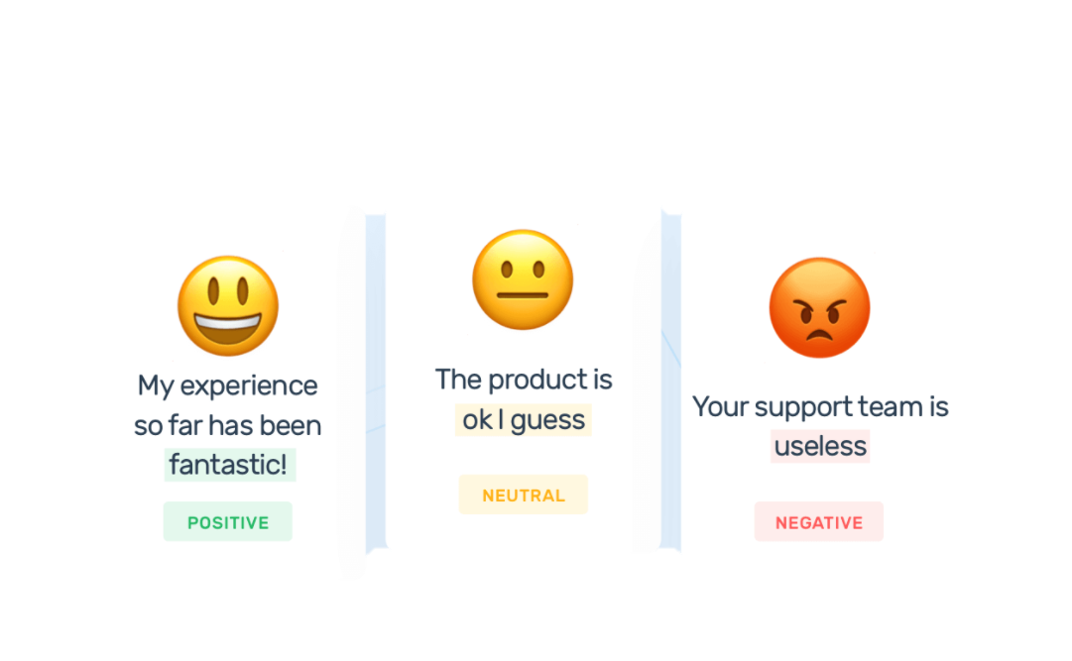
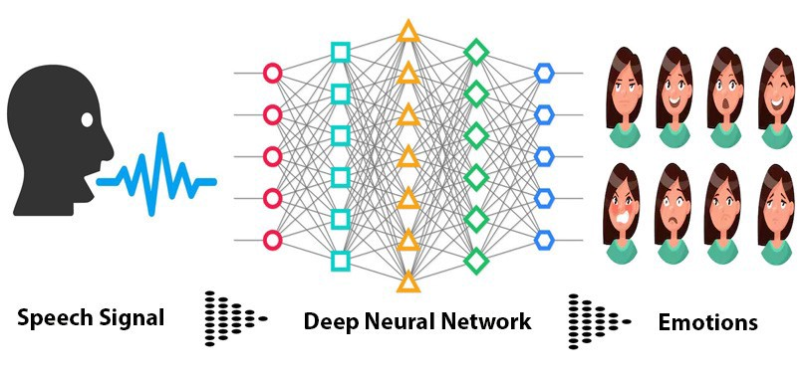
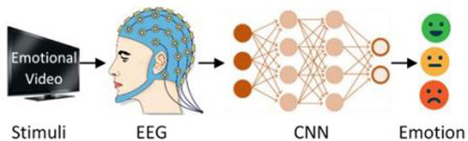
Emotion Recognition Methods
Facial expressions
Text Emotion Recognition
Speech Signals
Physiological signals
Notes:
Emotions can be recognized through facial expressions, voice tune, and phisiological signals.

Slide 5
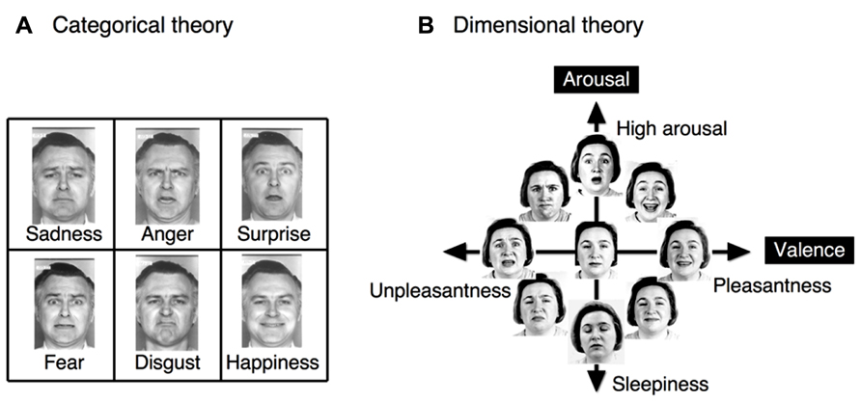
Emotional Models
To describe the general state of emotion, two different representations of models are utilized.
Categorical Theory
Dimensional Theory
Notes:
The first one is the categorical emotional model, which includes discrete emotions.
The second one is the multidimensional emotional model. It started with a two-dimensional model of valence and arousal.
Valence dimnesion represents the enjoyment of the emotion and ranges from negative to positive.
Arousal dimension represent the intensity of the emotion and ranges from calm to enthusiasim.

Slide 6
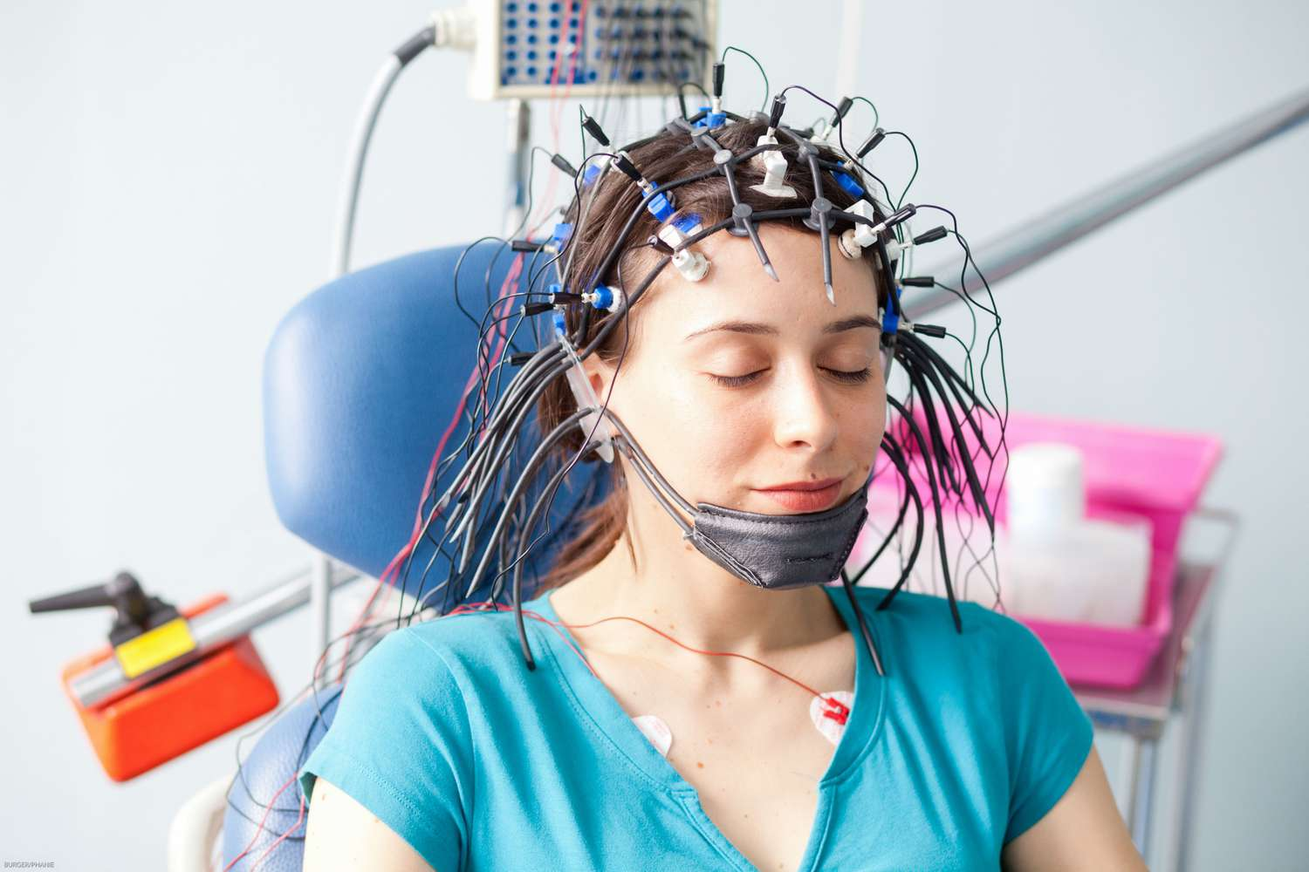
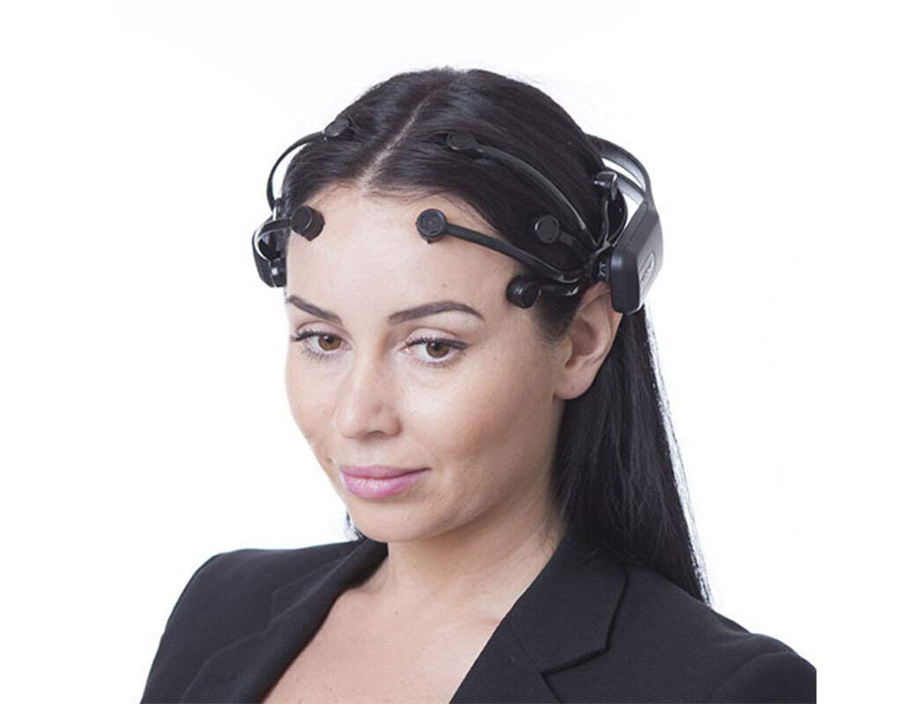
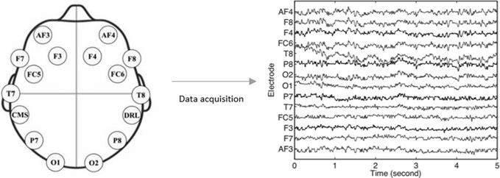
What is an EEG?
An electroencephalogram (EEG) is a test that measures electrical activity in the brain using small electrodes attached to the scalp.
Brain cells communicate via electrical impulses and are active all the time, even during asleep. This activity shows up as wavy lines on an EEG recording.

Slide 7
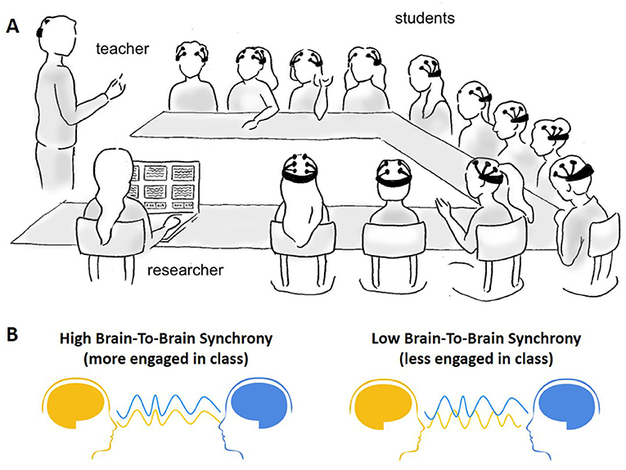
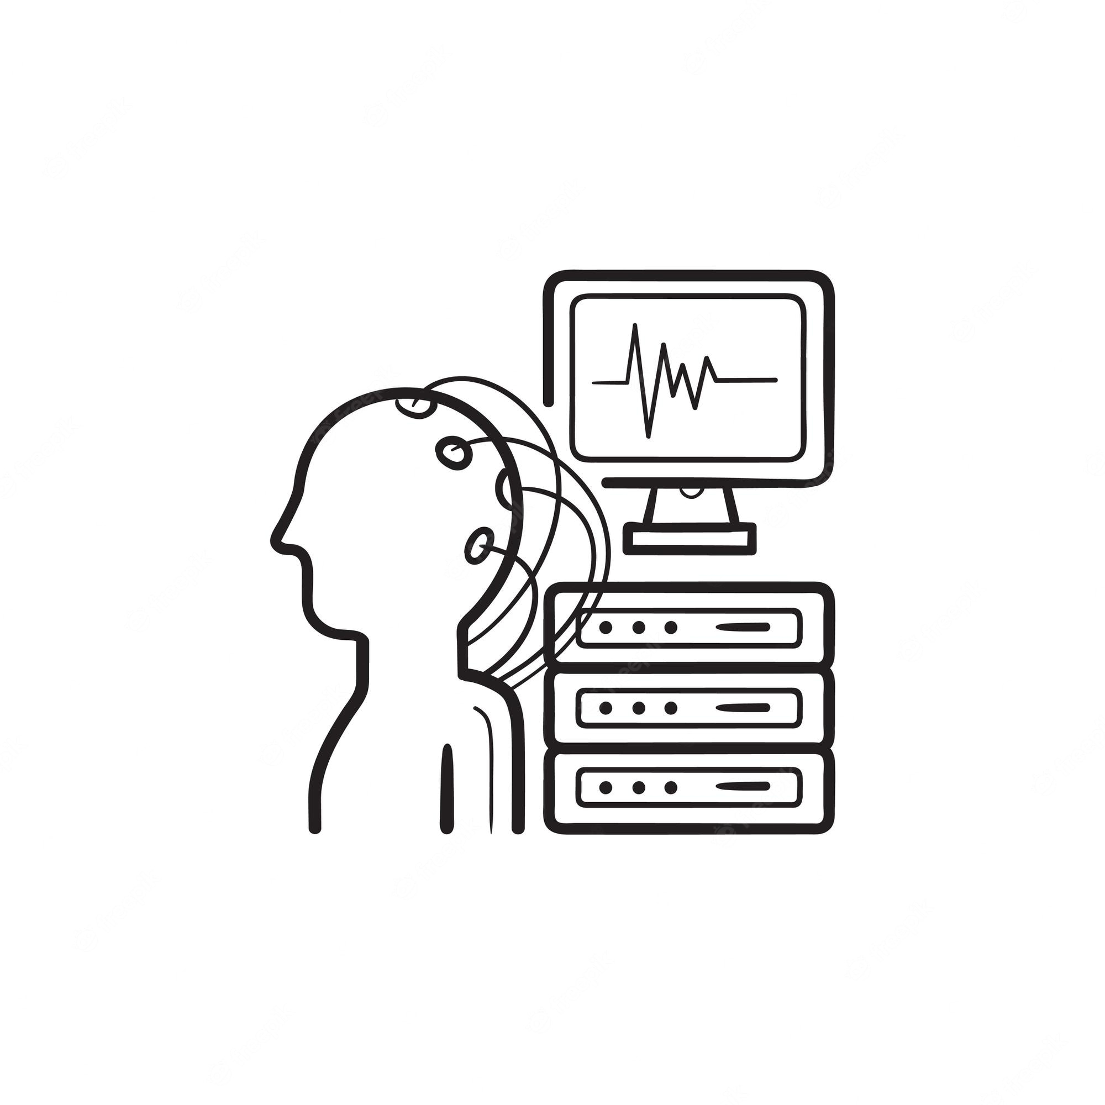

Applications of Emotion Recognition using EEG signals
Education
Medical diagnosis
Neuromarketing
Notes:
(Software can help doctors with the diagnosis of diseases such as depression and dementia by using voice analysis.)

Slide 8

Challenges of Developing ER model using EEG
Challenges from two aspects:
1
EEG Signals
2
Emotions
Maintaining an acceptable signal-to-noise ratio in non-invasive long-term recordings.
EEGs are unique for each person.
Emotions are complex!
Previous research has reveled that when emotions are evoked, there are some experiments which show that women's EEG signals tend to be similar, whereas men's EEG signals show greater individual variances [1].
[1] J.-Y. Zhu, W.-L. Zheng, and B.-L. Lu, “Cross-subject and cross-gender emotion classification from EEG,” in World Congress on Medical Physics and Biomedical Engineering, June 7-12, 2015, Toronto, Canada, 2015, pp. 1188–1191.
Notes:
Emotion recognition research has been argumentative and inconclusive
Scholars continue to debate whether each emotion occurs independently or whether there are correlations between distinct emotions.

Slide 9
RoadMap of Developing DL Model for ER using EEG
Preprocessing
Classification
Dataset Exploration
Performance Evaluation
Hyperparameter Tuning

Slide 10
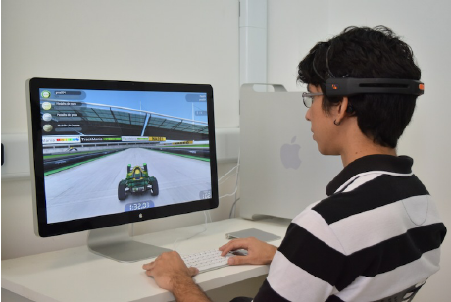
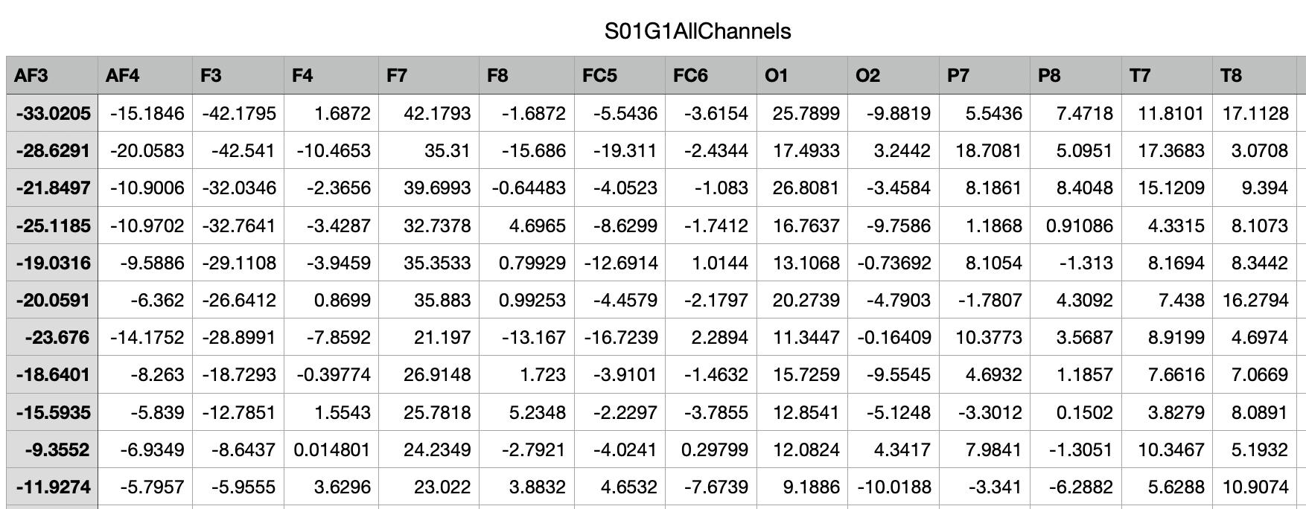
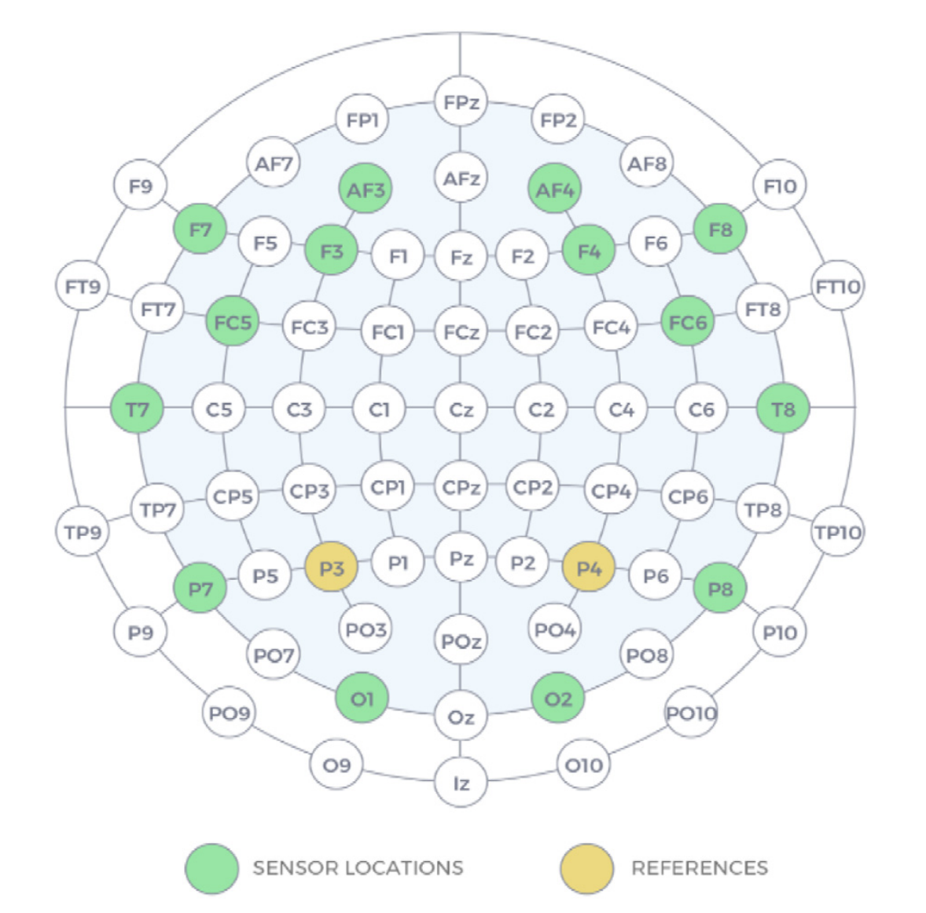
Dataset Description
This dataset includes computer games-based EEG signals.
They are collected from 28 different subjects with wearable and portable EEG device called 14 channel Emotiv Epoc+.
Subjects played emotionally 4 different computer games (boring, calm, horror and funny) for 5 minutes and totally 20 minutes long EEG data available for each subject.

Slide 11
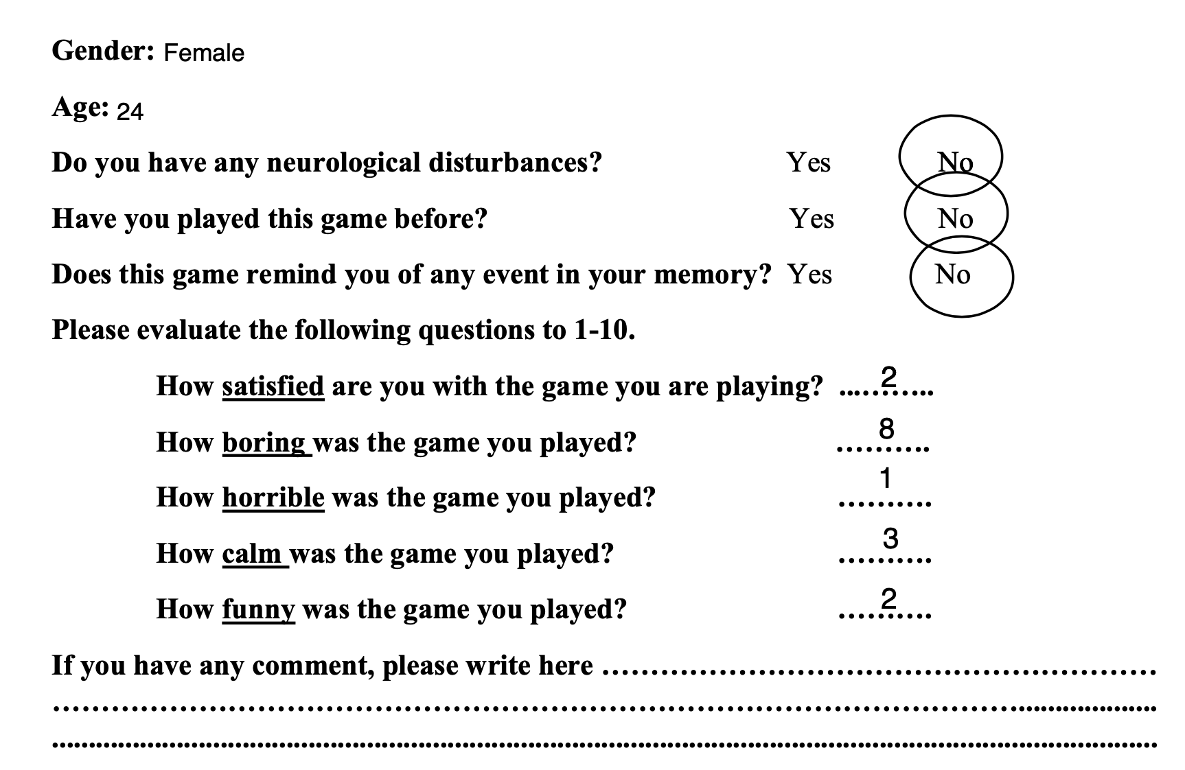
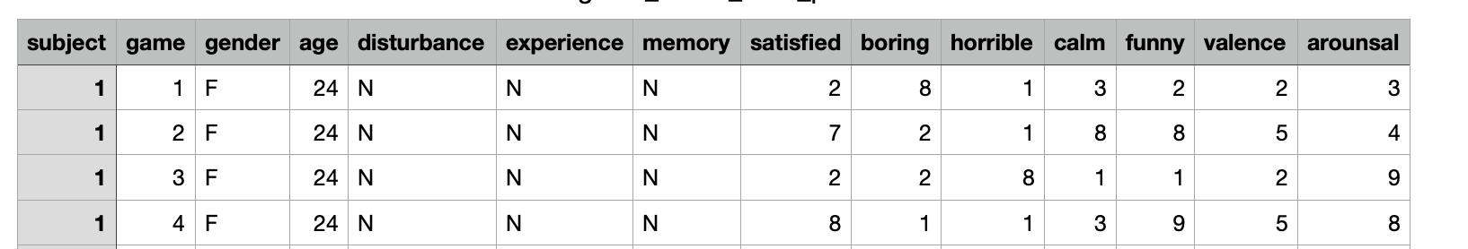
Preprocessing
The 5th order sinc filter is applied to remove artifacts resulting from movement of hands, head, and arms.
Notes:
Subjects rated each computer game based on the scale of arousal and valence by filling a form.

Slide 12
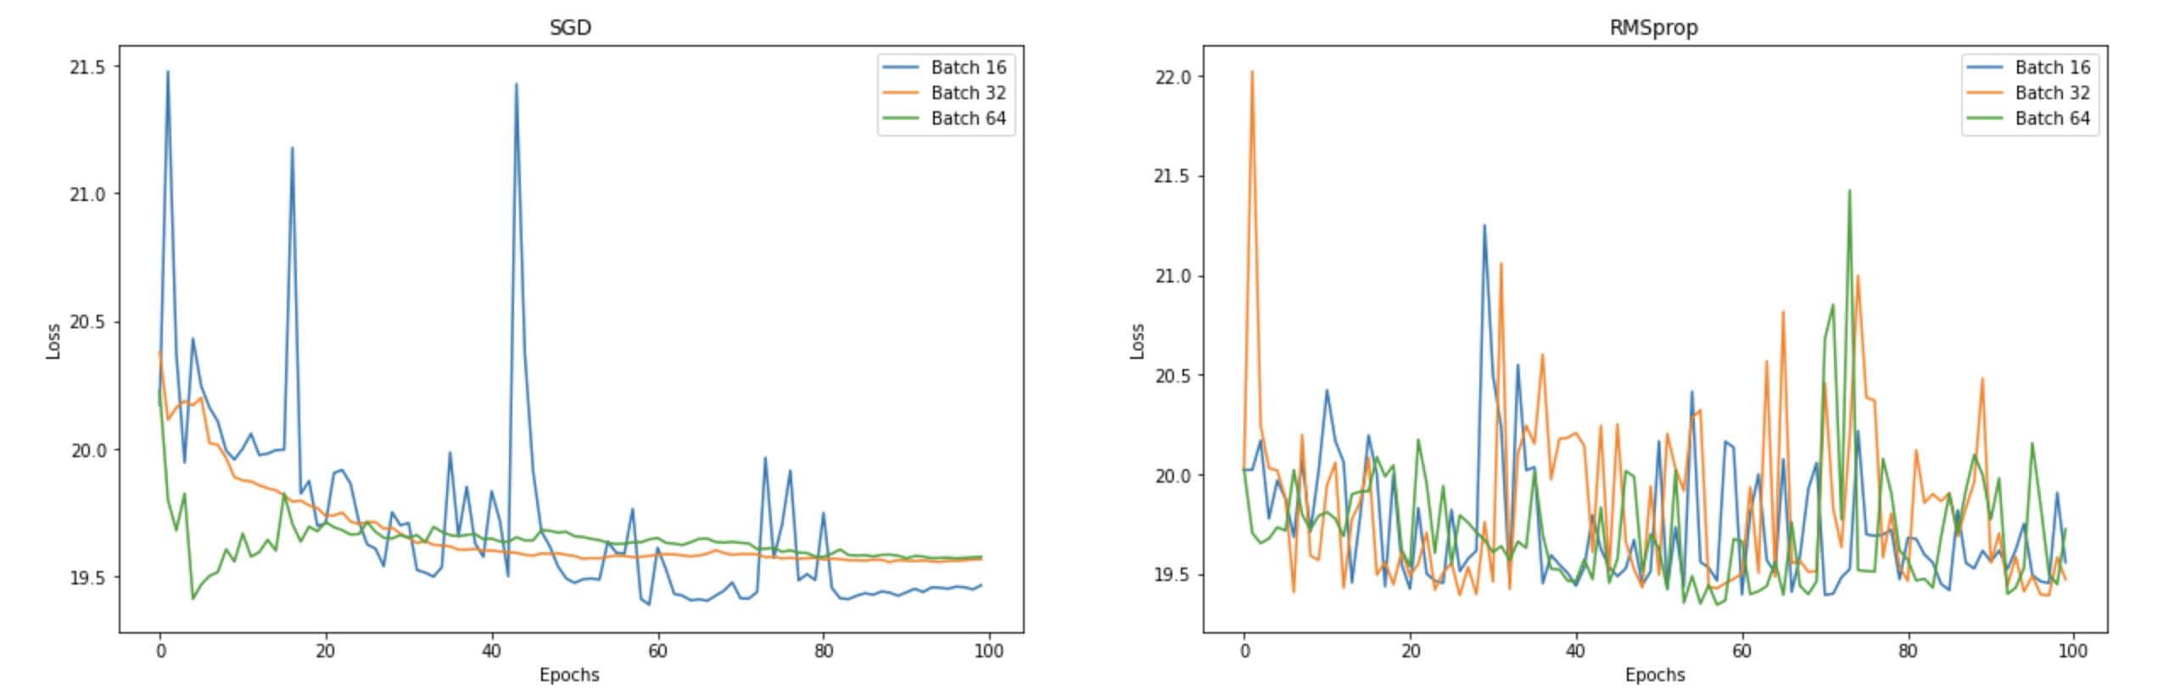
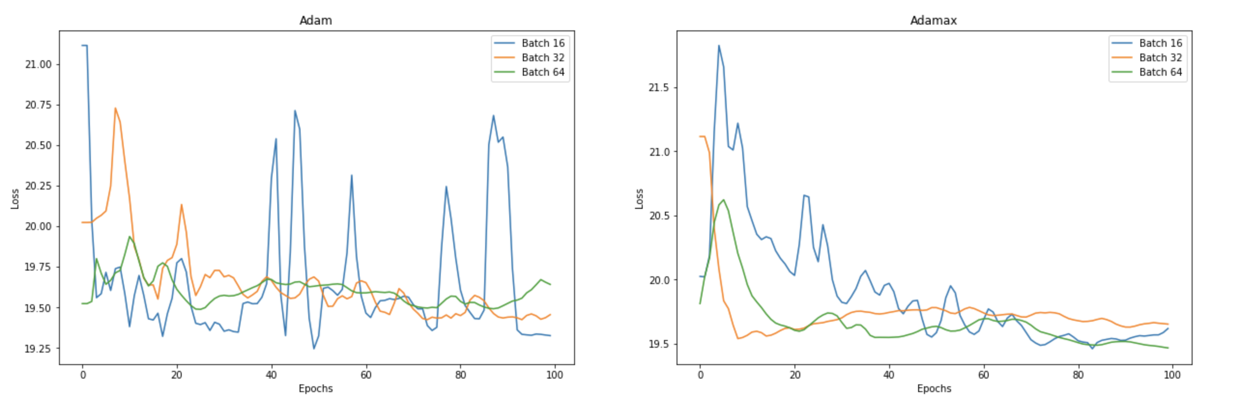
Hyper-parameter tuning

Slide 13
Hyper-parameter tuning

Slide 14
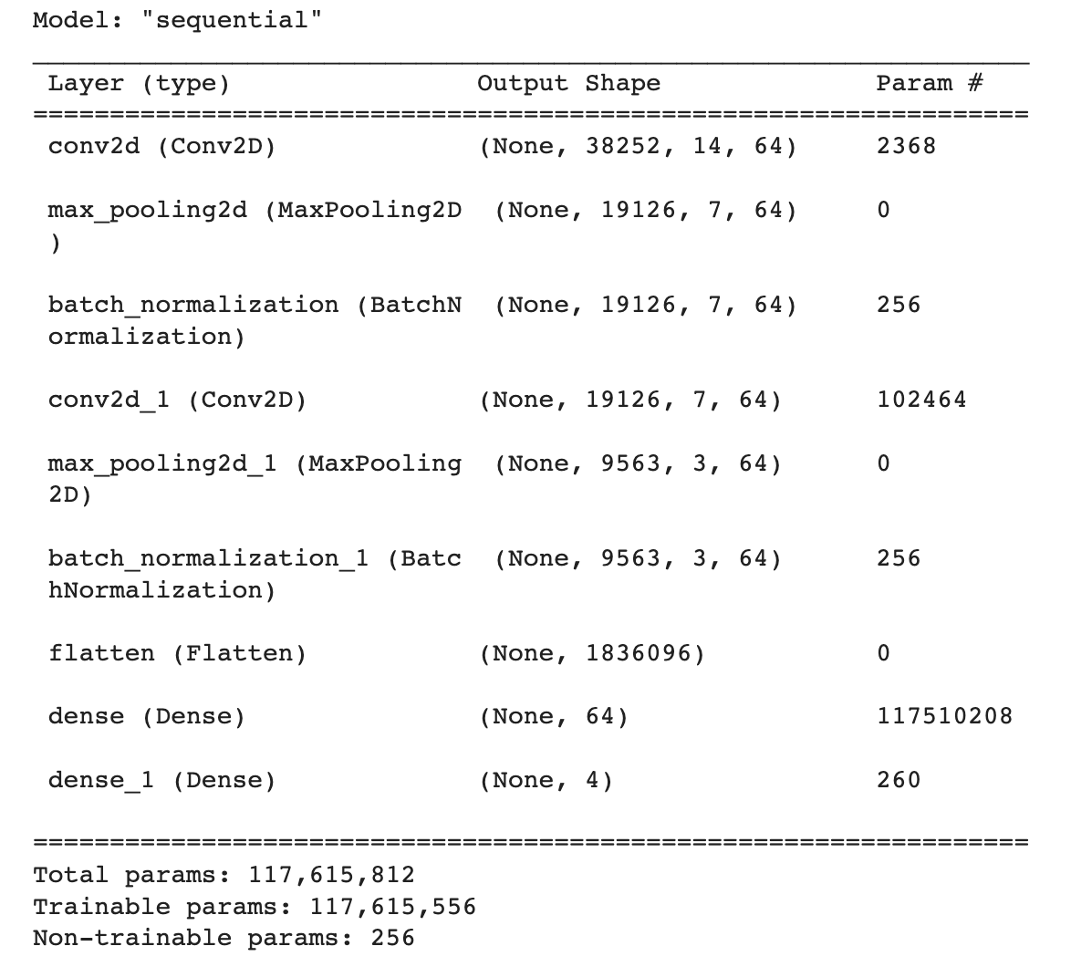
Classification
First Experiment

Slide 15
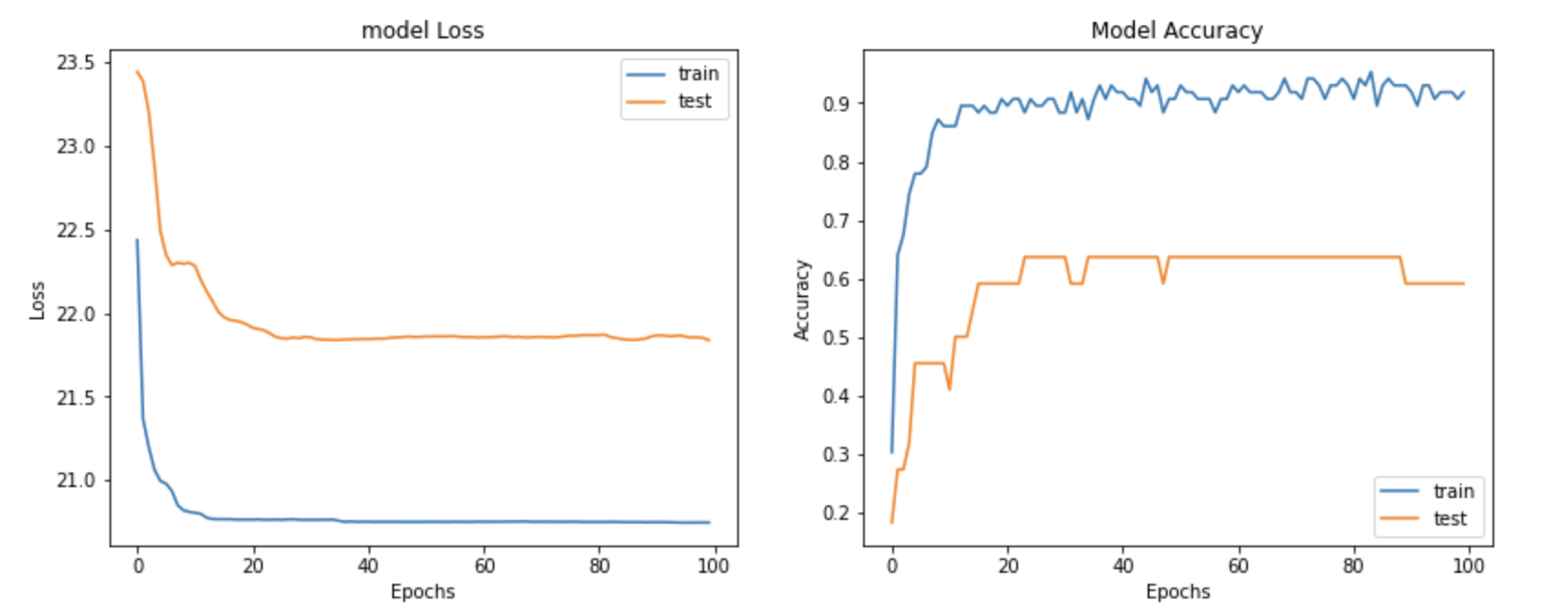
Performance Evaluation
First Experiment

Slide 16
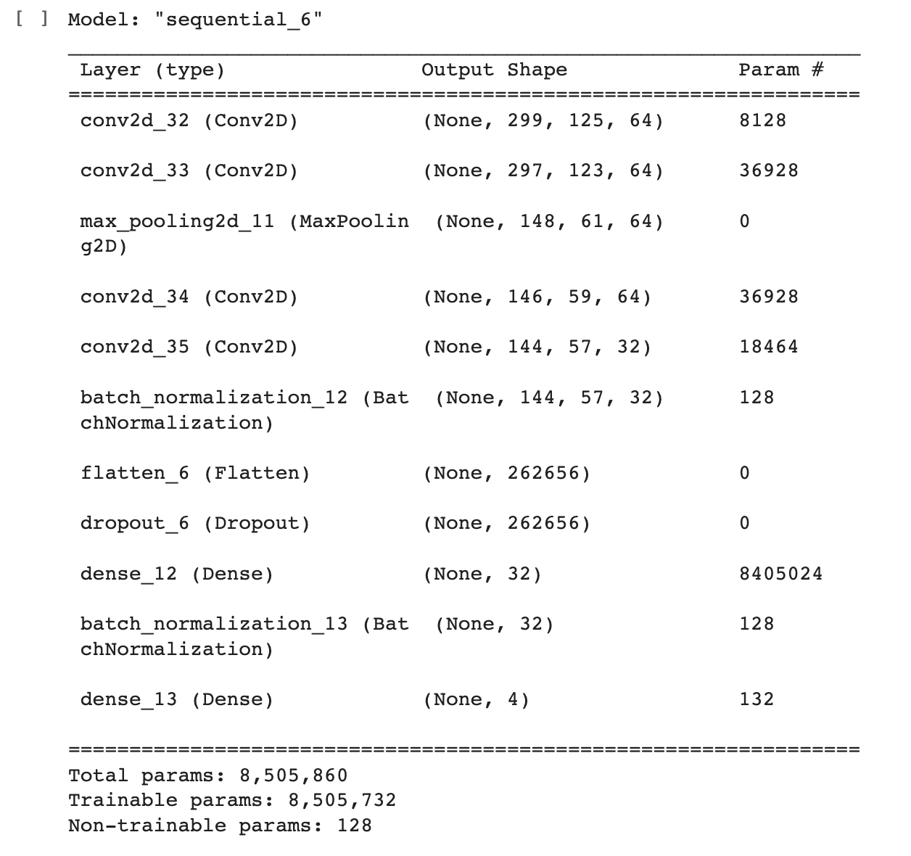
Classification
Final Experiment

Slide 17
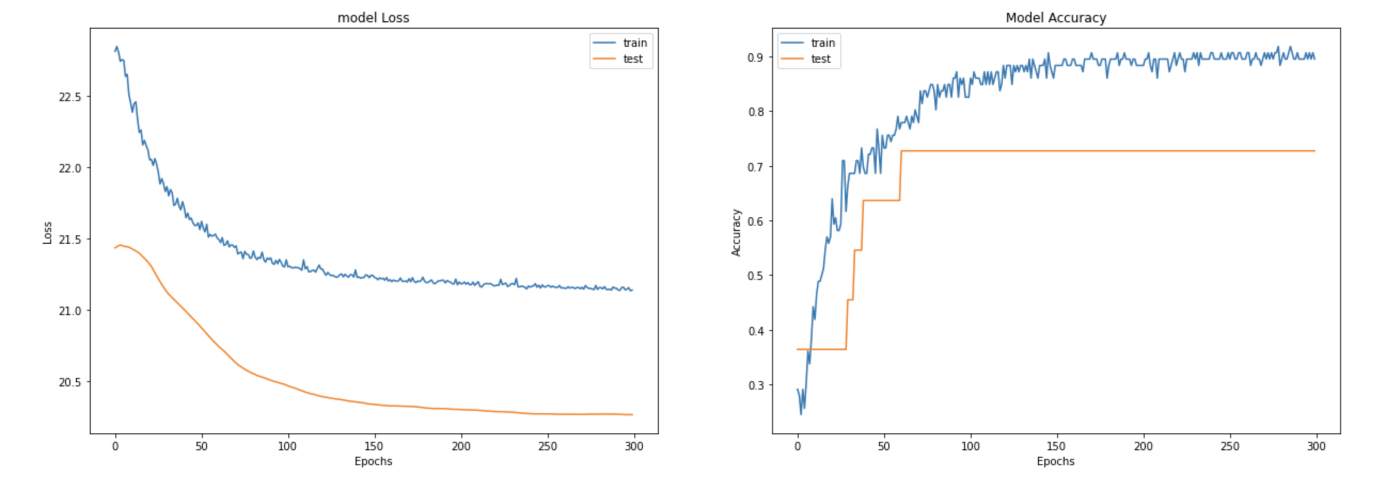
Performance Evaluation
Final Experiment

Slide 18
Conclusion and Future Work
Conclusion
Complex model (117 million trainable parameters) cause an overfitting.
Simple model (8 million trainable parameters) has lead to a better accuracy.
Apply Channel Selection.
Split the data based on the geneder and compare their accuracy.
Future Work

Slide 19

Thank you!
Thanks to Misk!
Thanks to Dr. Rick and Ms. Lujain!
Thanks to my colleagues!
Thanks to myself!
اغيب؟
والا اسكر الكاميرا واخذ غفوة؟
والا انسحب من الكورس؟

